Slide 1


TTK Healthcare Services
Policy Over View
Subex Limited
08/05/2010 To 07/05/2011
National Insurance Co. Ltd.
Notes:
04/16/10

Slide 2
MEDI CLAIM POLICY
The Mediclaim Policy Reimburses Expenses Incurred Due to a Disease, Illness or Accident.
The Mediclaim policy stipulates that a claim is admissible when the insured (beneficiary) is admitted in a hospital for a minimum of 24 hours for the treatment of a positive illness
24 hours hospitalization is a must. However this time limit is not applied to specific treatments i.e. Dialysis, Chemotherapy, Radiotherapy, Eye Surgery, Tonsillectomy taken in the Hospital/Nursing Home and the Insured is discharged on the same day. The treatment will be considered under hospitalization Benefit. Please note that these treatments will have to be necessarily availed as an inpatient only.
Notes:
04/16/10

Slide 3
Definition of Hospital
An institution established in India for indoor care & treatment of sickness
Registered with local authorities
Under supervision of registered & qualified medical practitioner
Minimum of 15 inpatient beds( In Smaller cities/ towns the same is reduced to 10 beds)
Fully equipped operation theatre
Fully qualified nursing staff 24/7
Fully qualified doctors 24/7
Notes:
04/16/10

Slide 4
Policy Benefits
> All Covered group Mediclaim policy.
> Pre-existing diseases are covered.
> 30 days waiting period waived
> First, second year exclusion, and fourth year exclusion are Waived.
> Maternity is covered Capped for Rs35000/- Normal and C- section -Rs50000/-
> Baby day one covered under maternity limit.

Slide 5
Policy Benefits
Room Rent Restricted to Rs3000/-Per day
ICU Capped Rs6000/-
Hospitalization & Surgeon, Anesthetist Medical Practitioner, Consultants Specials fees. Maximum limit per illness-25% of Sum Insured.
Anesthesia, Blood, Oxygen, OT charges, Surgical appliances, Medicines, drugs, Diagnostic Material & X-Ray, Dialysis, Chemotherapy, Radiotherapy, cost of pacemaker, artificial limbs and cost of stent and implant. Maximum limit per illness- 50% of Sum Insured

Slide 6
Expenses Not Payable
Admission/Registration
Telephone charges
Attendant's charges
Home Visit/Nursing charges - at residence after discharge
Assistant fee/Follow up charges in advance
Sundry/Medico Legal Charges/Diabetic chart charges
Thermometer Charges
Container for Specimen/Disposable Bag charges
Admission Kit
External Surgical Aids: Lumbo-sacral/Collar belt /Knee cap/Knee brace/ walker/hot water bag/baby kit/urine pot / traction kit/ folding commode etc.
Inhaler/ Nebulizer
Diet charges
Special/protein diet/health drinks unless prescribed by the doctor
Documentation/Folder/Stationery/In Patient chart charges
Notes:
04/16/10
16/04/10
And 4 lac claims

Slide 7
General Policy Exclusions
Injuries or diseases caused by war and war like operations
Circumcision, Vaccination, Inoculation, Cosmetic treatment, Plastic surgery
Spectacles, Contact lenses, Hearing Aids
Dental Treatment without hospitalization unless arising due to an accident
Convalescence, General weakness, Congenital external disease, Sterility, Venereal disease, Alcohol use, Self injury
AIDS
Diagnostic expenses not followed by active treatment for the ailment.
Vitamins and Tonics unrelated to treatment
Injuries or diseases caused by nuclear weapons
Abortion during first three months of pregnancy
Naturopathy treatment
Notes:
04/16/10
16/04/10

Slide 8
Hospitalization
24 hour hospitalization is a must
However this limit is relaxed in certain specific treatments such as
Dialysis Chemotherapy
Radiotherapy Eye Surgery
D&C Tonsillectomy
Lithotripsy (Kidney stone removal)
In such cases the patient may be discharged on the same day after the treatment.

Slide 9
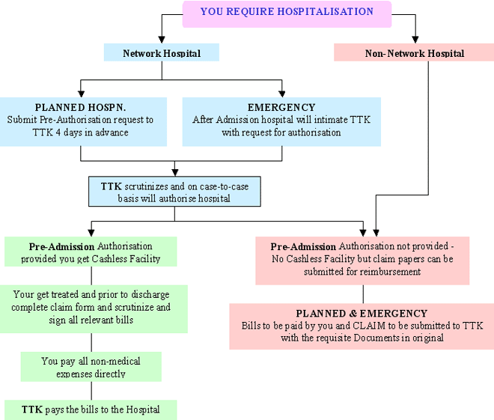
Cashless access for Hospitalization:

Slide 10
Cashless network across country
5500 Hospitals & Nursing homes and 450 Diagnostic labs in our network across the country in 353 locations.

Slide 11
Procedure For Reimbursement of Claims
Please submit the following documents in original
Discharge Summary. (Original ) .
Final Hospital Bill (with detailed break-up) &Cash paid Receipts (Original)
Medicine Bills along with Doctor Prescriptions.
Investigations & Test Reports. (Original)
Duly Filled Claim Form with Signature.
Note: In case of non-availability of prescriptions, kindly ask your Physician to countersign on the reverse of pharmacy bills.
Notes:
04/16/10
16/04/10

Slide 12
Reimbursement Checklist BASIC
Claim form duly signed must have enclosures -
Original and detailed Discharge Summary/Card
Original main bill with a complete breakup
Original Payment receipts
Original Diagnostic Test Reports performed on patient during hospitalization;
All Medical Bills must accompany the prescriptions.
TTK may ask for some more documents on a case to case basis.

Slide 13
In the event of …
..Shortfall: Please mention your email id in the claim form to intimate you on the shortfall documents, submit the documents to HR. All mail correspondences will be sent the HR with a cc to employees.
..Rejection: Final rejection will be done by the Insurance company. Initially it will be rejected by the TPA based on the policy terms and conditions, later it will be referred to insurance company for their opinion. A copy of the letter will be sent to the insured on the status.
..Disallowance: Please forward the necessary documents if not submitted before for the disallowed amount within 7 working days to process disallowance as an addendum basis.

Slide 14
TAT – Turn Around Time
Enrollment 3 to 7 Days
Claims Reimbursement 15 Days
Claims Investigations Based on Medical Out lier
Predefined processes for a integrated seamless service model
Processes critical to financial outcome and customer satisfaction have been identified and fine tuned
Focus on quality, efficiency and accuracy
Notes:
04/16/10

Slide 15
IMPORTANT NOTE
1. Claims for reimbursement should be submitted to TTK within 30 days from the date of discharge. Late submission of claims will not accepted by TTK.

Slide 16
Contact Points
Back end Numbers for employees for claim status and Query
080-41255305 works from 9 to 6 on weekdays And 1800- 485 -8885 (24/7)
Email :- blrfront@ttkhealthcareservices.com
Mr Anand
Email: anand@ttkhealthcareservices.com
Mr Karthik
Email:karthik@ttkhealthcareservices.com
Address
TTK HEALTHCARE TPA PVT. LTD.
# 2, H.B. Complex, 100 ft BTM Ring Road, BTM 1st Stage,
BTM Layout, Bangalore:560068
Phones: 080-4012 5678 | Fax: 080- 41255797
Call Center No: +91 98452 48885

Slide 17
24 / 7 Call Center Services
CITY SPECIFIC TOLL-FREE NUMBERS
TOLL FREE TELEPHONE NOS.
TTK HO CALL CENTER | 1800 425 8885
TTK HO CALL CENTER | 1800 425 7878
TTK CHENNAI CALL CENTER | 1800 425 7575
TTK MUM CALL CENTER | 1800 22 1717
TTK COCHIN CALL CENTER | 1800 425 6264
TTK HYD CALL CENTER | 1800 345 4051
ICICI CALL CENTER | 1800 229 229
CITI BANK TOLL FREE NO. | 1800 425 4448
TTK KOL CALL CENTER | 1800 345 7069
TOLL FREE FAX NOS.
TTK HO FAX NO. | 1800 425 2626
MUMBAI FAX NO. | 1800 22 1919
COCHIN FAX NO. | 1800 425 6262
CHENNAI FAX.NO. | 1800 425 7474
24 hr Toll free Help line to provide assistance with:
  Hospitalization-Pre-authorization related queries – approval status, reason for partial rejection etc
  Policy Scope and Coverage related queries
  Enrollment ID Card queries
  Information on Network hospitals
  Claim Related queries
Notes:
04/16/10
Updated as per new features.

